Slide 1

SlugHub
July 25th, 2019
Lawrence Tam (Product Owner)
Naum Markenzon
Mason Nguyen
Xuhua Feng
Zhelin Li
Where Slugs Can Find Themselves At Home.

Slide 2
Product Vision
Problem
Question: what problems do UCSC students have?
Searching for UCSC and academic related resources is really a hassle sometimes.
Access to information on student life activities and niche resources is mostly reliant on word-of-mouth.
Notes:
What’s the direct and indirect competition (be clear)
Why dont we just yelp stuff, google search stuff
Who’s going to own it, drive changes
maintaining? How often does this need to be updated
“How do i know if i dont need this lol”
Marketing -- how can we make this viral
This isolates groups and becomes an issue for our campus culture.
From giving instant access to myUCSC and Canvas, to providing course offering information and dining hall hours - this app will make UCSC resources much more accessible to students.

Slide 3
Product Vision
Solution
Built a mobile app that acts as a hub for student affairs and raises awareness for both well known and less well known resources that UC Santa Cruz provides.
Why?
Accessibility
Campus Culture
Better Funding
Notes:
This isolates groups and becomes an issue for our campus culture.
From giving instant access to myUCSC and Canvas, to providing course offering information and dining hall hours - this app will make UCSC resources much more accessible to students.

Slide 4
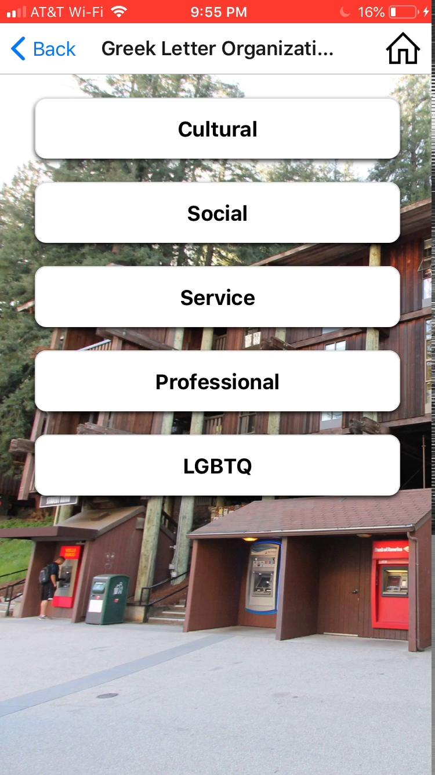
Demo of SlugHub
Stay tuned as we demonstrate our app!

Slide 5
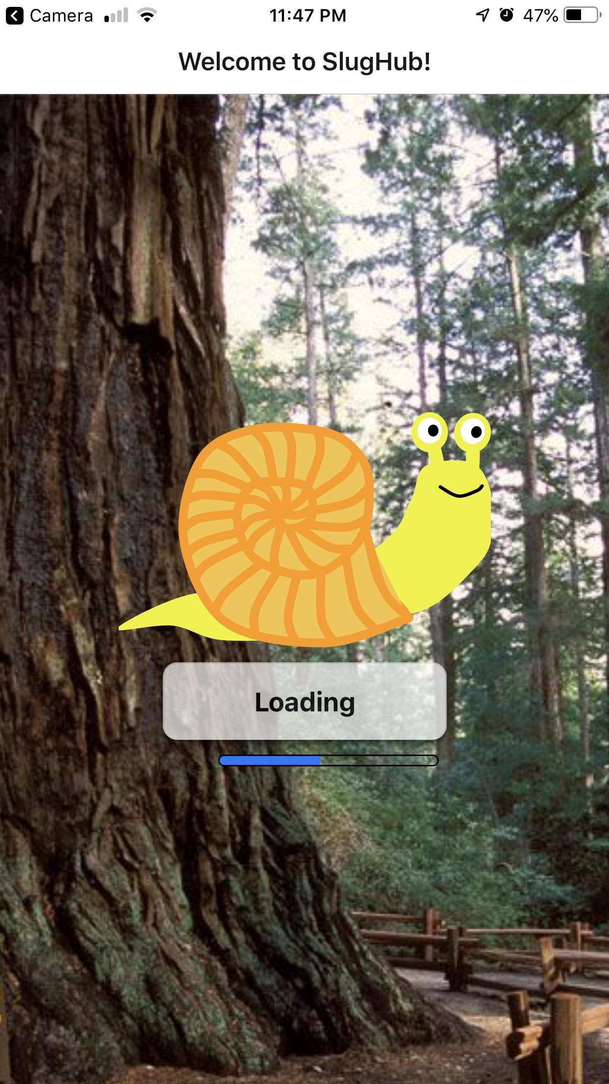
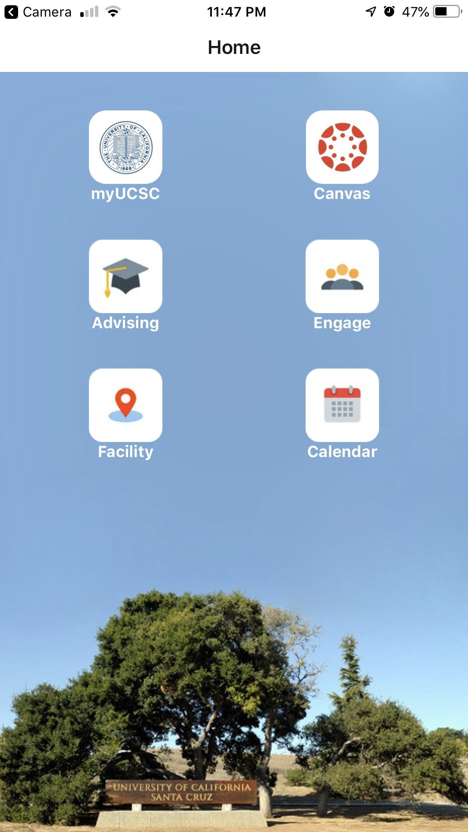
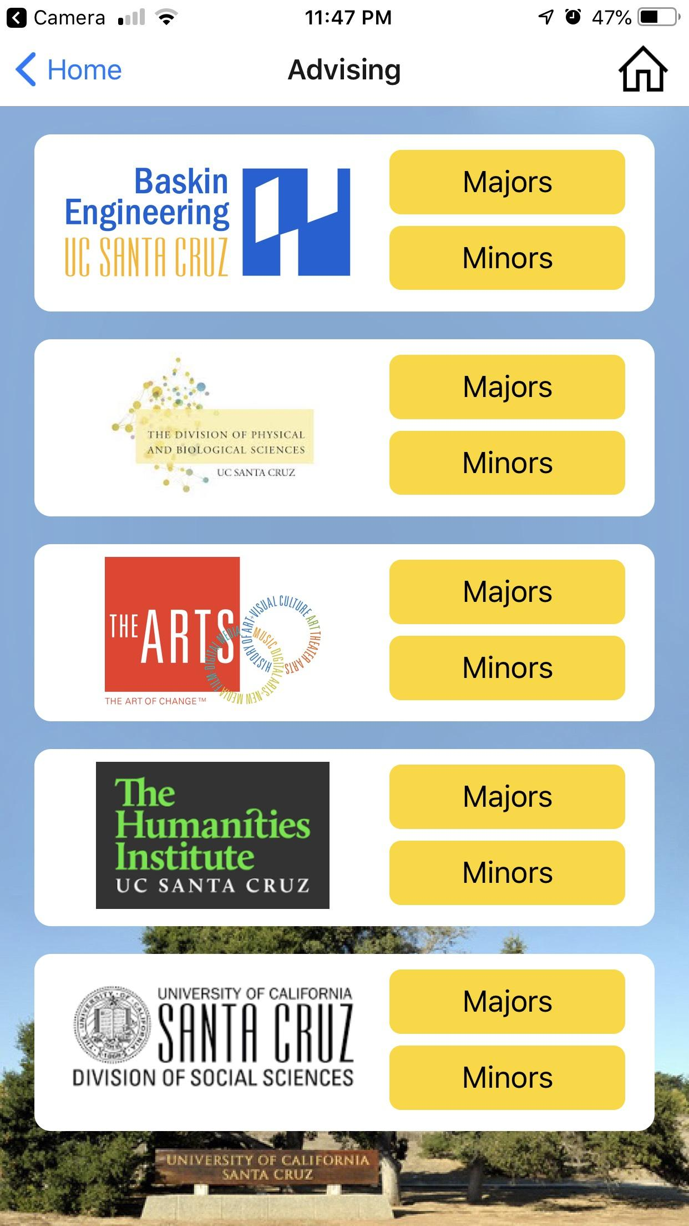
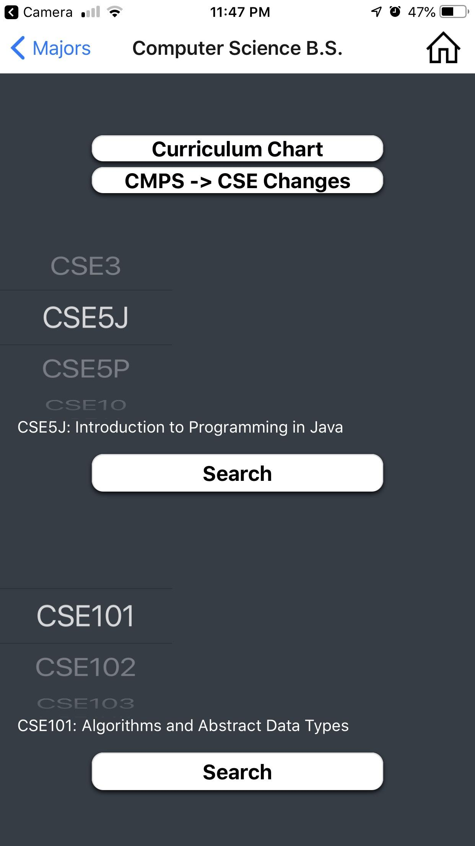
Demo of SlugHub
Notes:
Offline mode?
Favorites
Ad revenue?? Somehow
Local business - sales rep
Funding

Slide 6
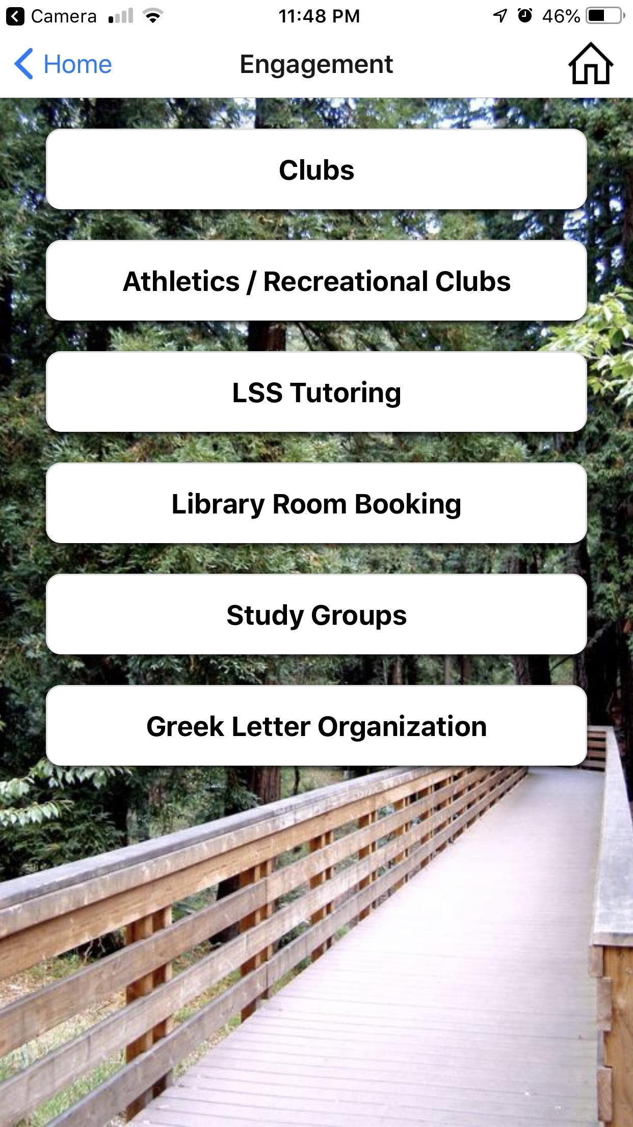
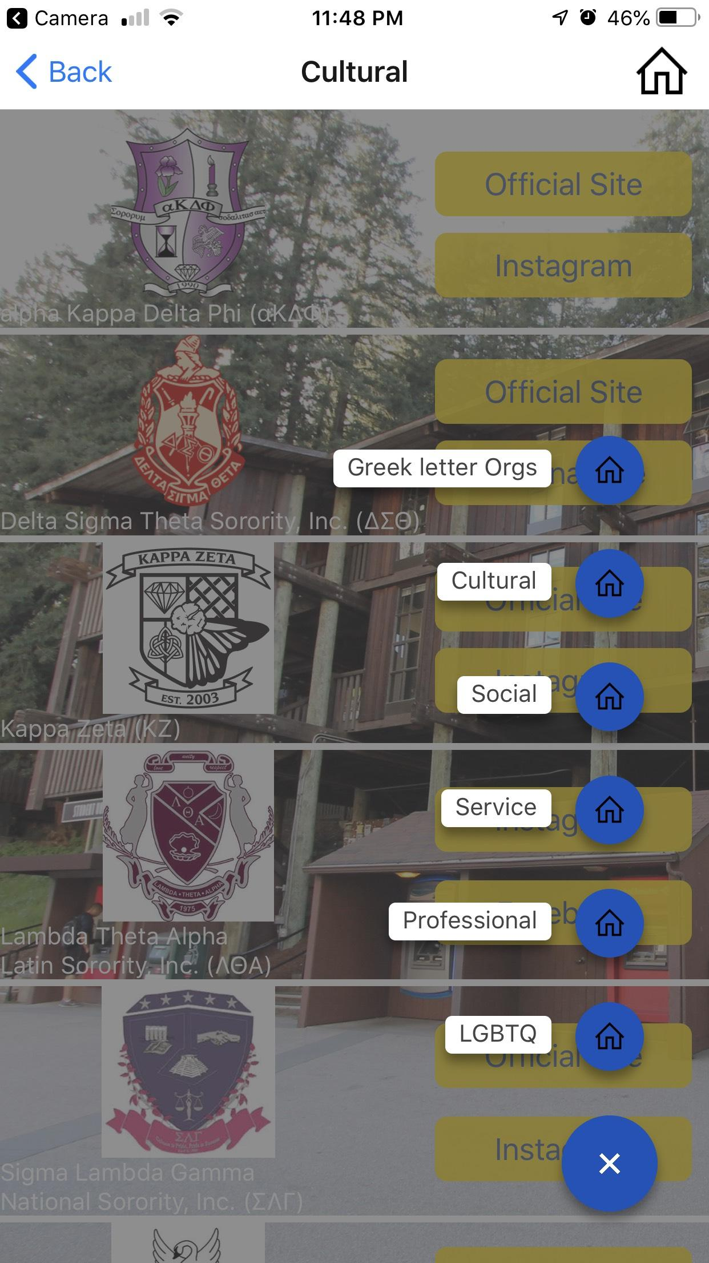
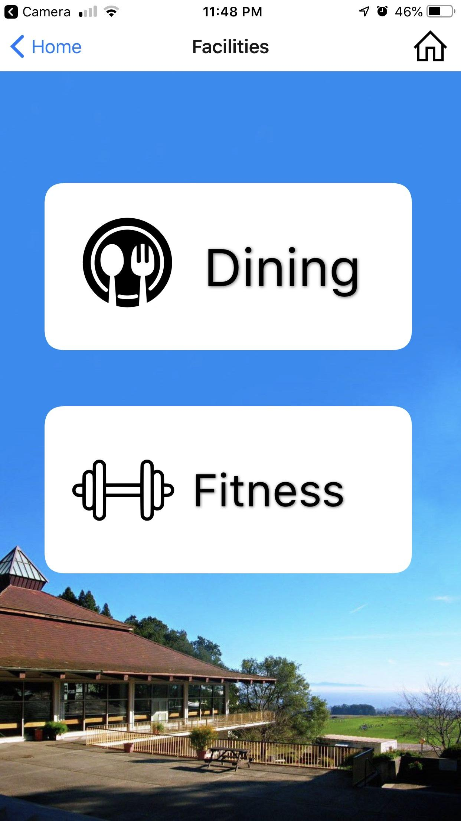
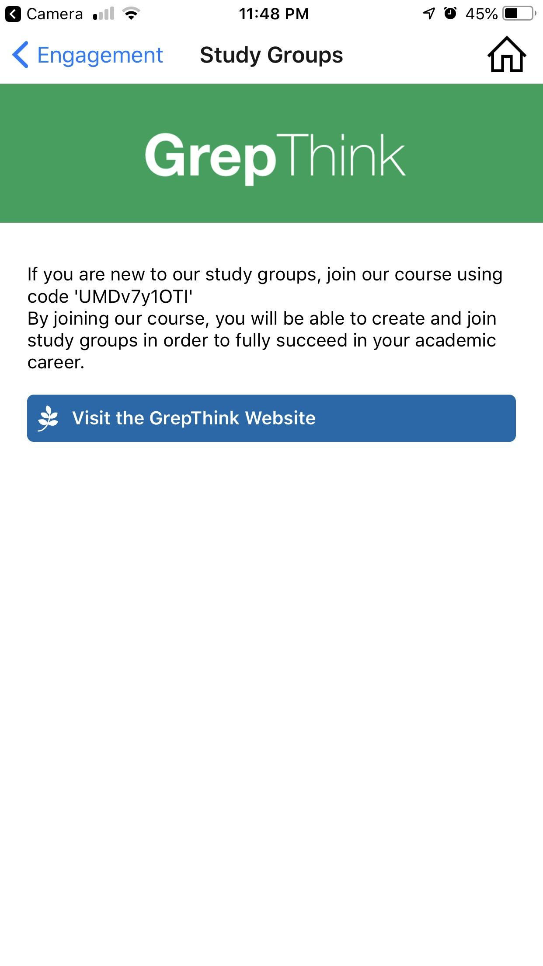
Demo of SlugHub

Slide 7

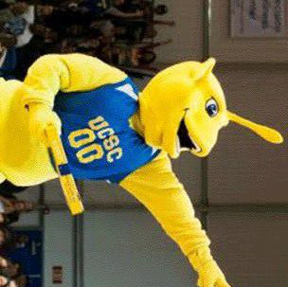
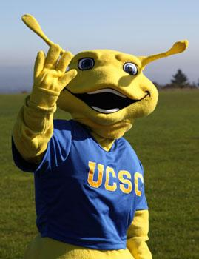
Technologies
React Native Framework (Cross Platform between iPhone + Android)
Javascript
Node.js
Python
Expo Bundler (Simulator)
BeautifulSoup (Webscraping)
Paramiko (Server Connecting)
Git (Version Control)
Bash Shell Scripting (Automation)

Slide 8
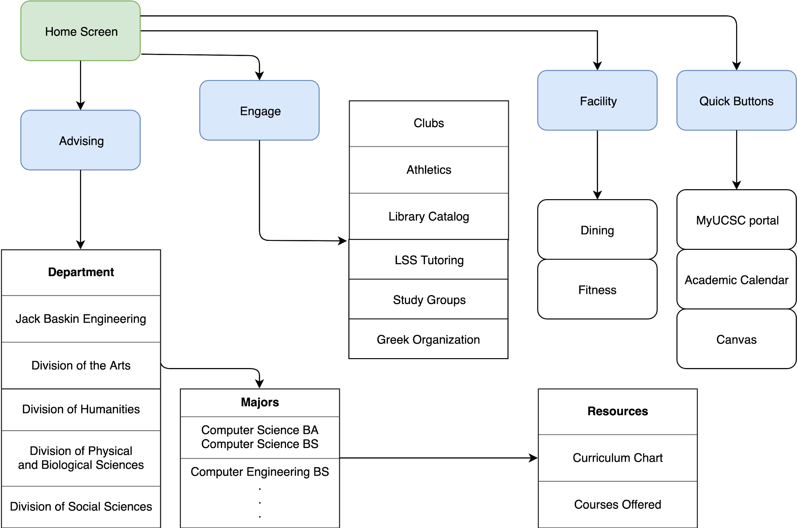
Architecture
Notes:
Continuing minimum viable product for the future (beyond minimum viable?)
Make it more scalable/ maintainable

Slide 9
Project timeline
Welcome Week
Sprint 1
Sprint 2
Sprint 3
Setting up React
App foundations
Bulk up features
UI and Finalizations
Design the Screen Architecture
Home Screen
Advising Screen
Web scraping
Engagement
Portal & Canvas
File Automation
Adding backgrounds
Making buttons
Stylesheet + Layouts
Calendar
Facilities

Slide 10
Project Management Strategies
Constant communication (texting & in-person)
SCRUM meetings almost every weekday
File management
Google Drive
Github
SCRUM documentation
Trello board => task management
Google Docs => release and sprint planning
Google Excel => burn up chart
Flowchart.drawio => app architecture planning
Weekly Scrum Master switching
UI/UX planning
Adobe XD and whiteboard drawings

Slide 11
Successes and Improvements
01
Learning how to use React Native was a huge hurdle, but ended up paying off well in the end.
02
A short time span. We were very ambitious and had to cut out a significant portion of functionality.
03
Learning UI principles to make our app aesthetically pleasing.

Slide 12
What We Enjoyed & Didn’t Enjoy
Enjoyed:
Balancing functionality with UI
Effectively distributing labor intensive work
Great teamwork and communication
Sharing the same vision about our product
Didn’t Enjoy:
Completing high story cost goals
Being too ambitious
Unable to achieve a part of our vision and user stories
Large amount of documents

Slide 13
Lessons Learned
How to Web scrape data from the Internet
How to Automate Server Connection and File Transfer
How to be Agile Developers
How to be a Product Owner
How to be a Scrum Master
How to plan Sprints effectively
How to implement UI in Applications
How to utilize Google API + Google Scripting
How to work effectively as a team
How to manage tasks
How to manage time effectively

Slide 14
Future Plans with the App
Hopefully one day this idea/prototype will become an official campus application
Calendar notifications, login and personalization feature, and google maps API
Network to learn about resources on campus to add to the app (Virtual Reality lab, 3D printing lab, camera equipment lab, etc) -- very cool stuff that nobody knows about

Slide 15
Thank you!
Check out our app when it goes live (hopefully)

